Slide 1

Kingsbury High School
CLASS OF 2014
Graduation Requirements
And Course Selection Information

Slide 2

Kingsbury High School
Academies
Bioscience
Prepares students for the growing field of Bioscience through a rigorous curriculum and potential internships.
Course of Studies Includes:
Health Science Courses
Foundations of Technology
Anatomy & Physiology
AP Biology and AP Chemistry
AP Calculus
Information Technology
Introduces students to career opportunities in the modern world of technology.
Course of Studies gives students a strong foundation in math , science and technology through courses including:
Foundations of Technology
Programming I & II
AP math and science courses
Global Studies
Prepares students for success to compete in the global marketplace through rigorous coursework taught from a global perspective.
Course of Studies is tailored to each student's specific career interest.

Slide 3
TENNESSEE GRADUATION REQUIREMENTS:
22 CREDITS
English
4 Credits
Science
3 Credits
Biology
Chemistry or Physics
3rd Lab Science
Social Studies
3.5 Credits
World History/Geography
US History
US Gov. & Economics
Personal Finance
Health
1.5 Credits
Lifetime Wellness
0.5 Health or
Participation in Athletics
Elective Focus
3 Credits
- Capstone Project
- Computer Experience
Math
4 Credits
Algebra I
(8th gr. Alg. doesn't count as 1 of the 4 required HS math credits)
Geometry
Algebra II
Math Beyond..

Slide 4

Elective Focus Categories
No double dipping!
You cannot use classes being used to fulfill graduation requirements!
For example- ROTC III cannot be used if it fulfills
your US Gov. or Per. Finance requirement!
____________________________________________________________________________________________________
Humanities (Classes in the following subject areas: English, Social Studies,
World Languages)
Math/Science (Math & Science classes - includes 8th grade Algebra I)
Fine Art (All Fine Art classes including: Art, Music, Theatre, Etc.)
HPELW (Mixes PE with Health & Medical classes)
AP/IB/Dual Enrollment (Can double-dip! Ex. -AP English can be used
for both grad. requirements and elect. focus)
CTE (3 credits in Career and Technology Ed. in a vocational focus)
College Readiness (Any 3 “plus” or “A” classes and service learning )
Career Readiness (CTE courses, Coop, School Spons. Ent., and certain computer based online courses)
ROTC
For More information, see the SCS curriculum guide.

Slide 5
COLLEGE PREP PROGRAMS
AP Program
Why Choose AP?
Opportunity to take college level courses in a high school setting.
Potential to earn college credits or advanced placement.
Students who participate in the AP program are more likely to earn a bachelors degree.
Potential AP Courses Offered at KHS
AP English Literature
AP English Language
AP U.S. History
AP Biology
AP Calculus
AP Statistics
AP Psychology
AP Studio Art
Qualifications
Good Academic Standing and Test Scores
Teacher Recommendations
AP Teacher Approval
AP Exam Participation is REQUIRED
Dual Enrollment Program
Why Choose Dual Enrollment?
Opportunity to take college level courses in a college setting.
First hand college experience before going to college full-time.
Potential to earn college credits.
Potential Dual Enrollment Courses
Composition I & II Calculus I & II
Biology I & II U.S. History I & II
Calculus I & II Statistics I & II
Chemistry I & II Art Appreciation
Microeconomics Government
Qualifications
ACT Composite Score of 19 or higher
ACT Subject area Score of 19 or higher
Submit all admissions paperwork to the appropriate offices by the stated deadlines
Administrator’s Approval

Slide 6
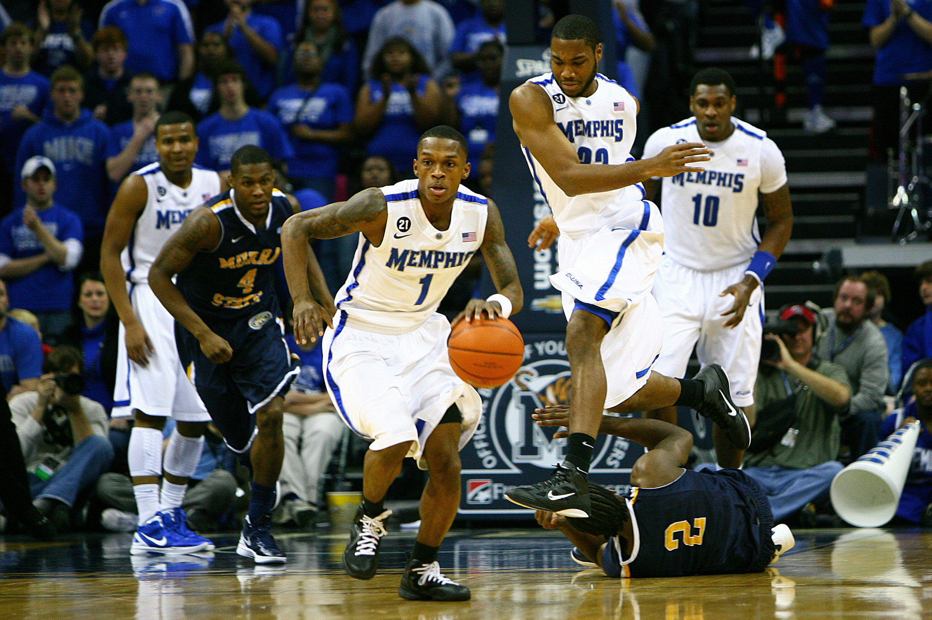
NCAA Clearinghouse
In order to participate in NCAA Division I or II athletics, you have to be certified by the NCAA Eligibility Center.
You must qualify academically and you must be cleared as an amateur
student-athlete.
Steps to Qualification
Junior Year -
Register with the NCAA Eligibility Center at the beginning of your junior year
Make sure that you are on track to graduate ON TIME
Make sure that you have the required amount of Core Courses
At the end of your Junior year, have your transcript sent to NCAA
Send your ACT scores to NCAA ‘s Code “9999”
Senior Year -
Update your information
Request Amateurism Certification
Graduate and send your Final Transcript!
Find more info at: www.eligibilitycenter.org

Slide 7
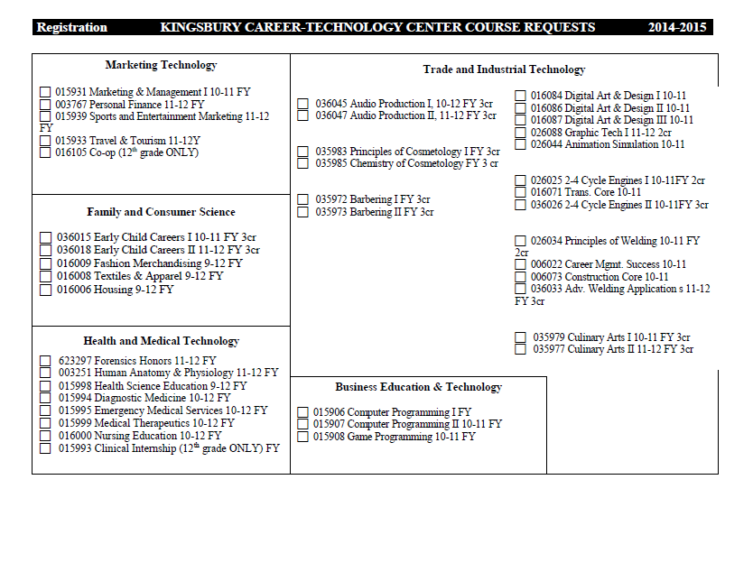
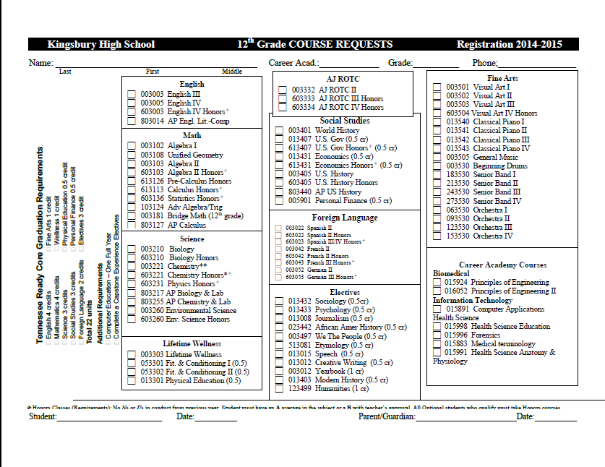
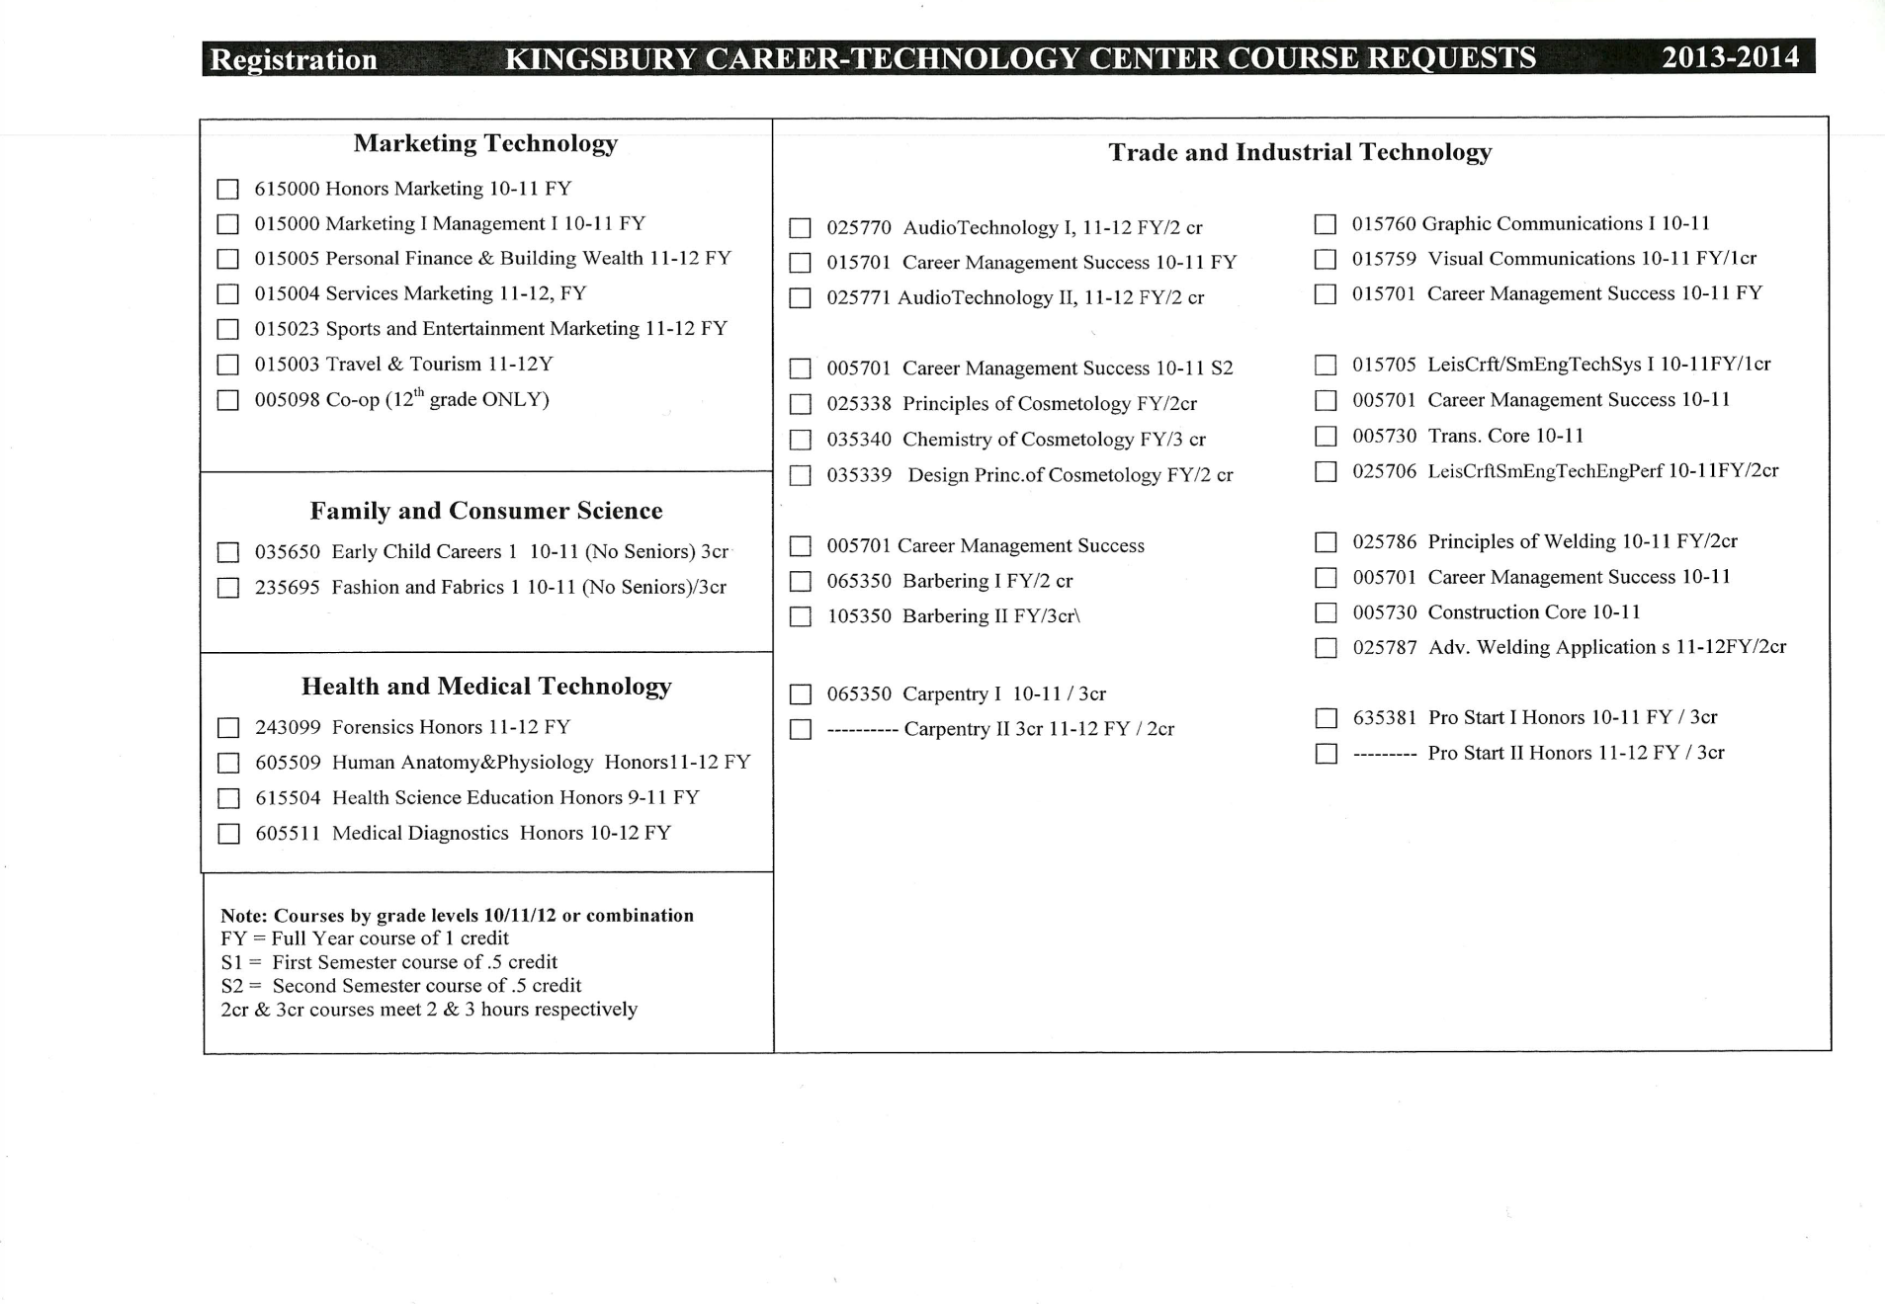

Slide 9

GET THE CLASSES YOU WANT…
There are situations where it is not possible for you to get all of the classes you chose such as:
  Two of your chosen classes are offered at the same time
  KHS does not have the staffing to offer the chosen class
  Classes are at capacity when you register
Increase the odds of getting the classes you want by:
  Completing a course selection form
  Registering on the assigned school registration day
  Attending school on day 1!
Remember that schedules are dropped for all students who do not attend the first day of school! To ensure you get the classes you want, be sure to register on time and begin attending school the first day!

